Slide 1

Bank Loan Analysis: Key Insights
This presentation provides a comprehensive analysis of financial loan data, highlighting trends in applications, funding, and defaults. We will explore key metrics and regional variations to understand the landscape of loan performance.
- Krish Mehta

Slide 2
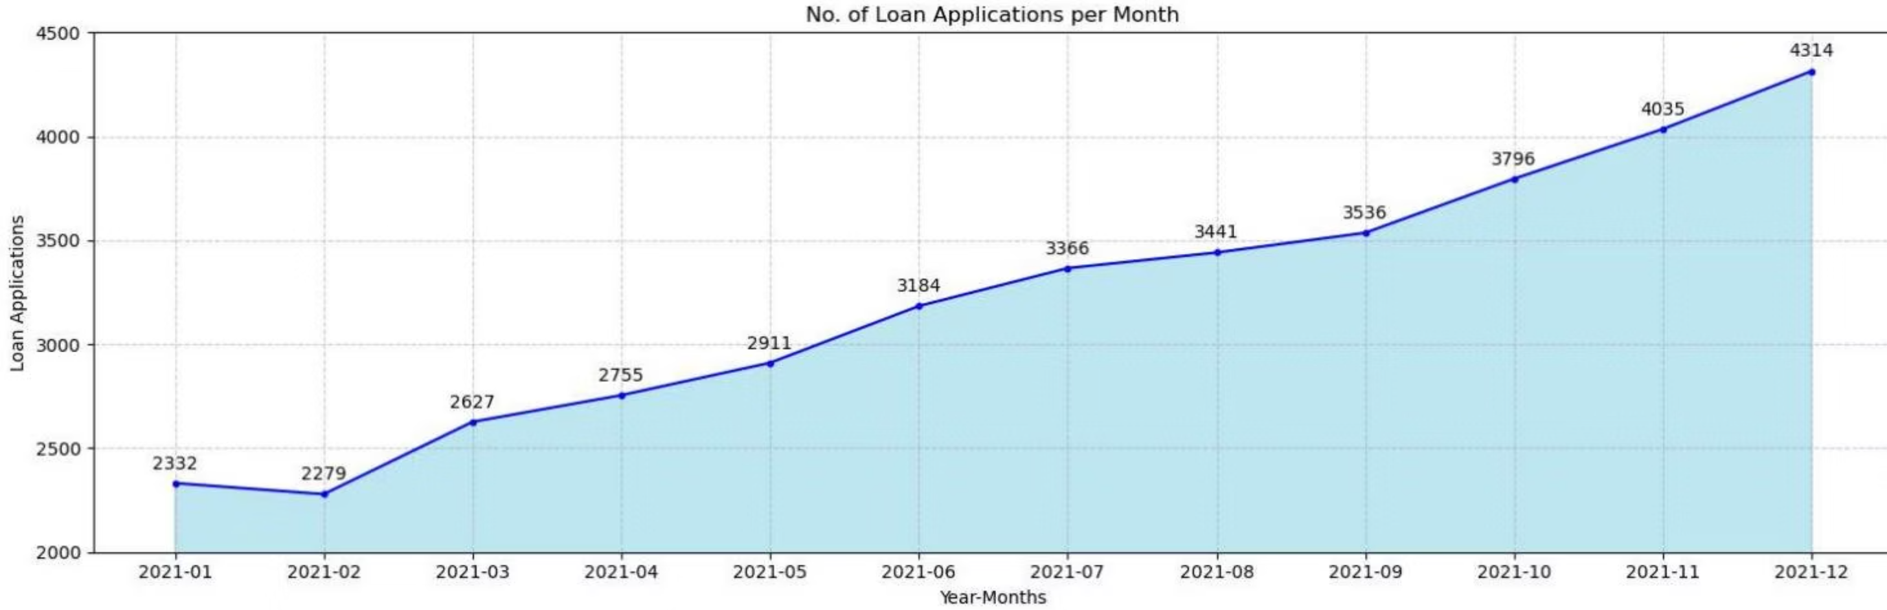
Loan Application Trends
Monthly Loan Applications
Total loan applications show a consistent upward trend throughout 2021, culminating in 4,314 applications in December. This indicates a growing demand for
financial loans.
Total Applications
Latest Month (Dec 2021)
38,576
4,314

Slide 3
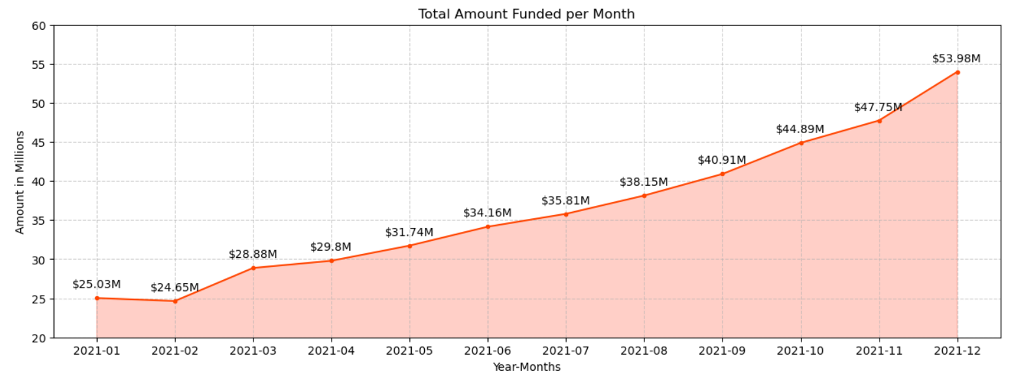
Funding & Payments Overview
Monthly Funded Amounts
The total amount funded also increased month-over-month, reaching $53.98 million in December 2021. This growth aligns with the rising number of loan applications.
Total Funded Amount
Total Amount Received
$435.76 M
$473.07 M

Slide 4
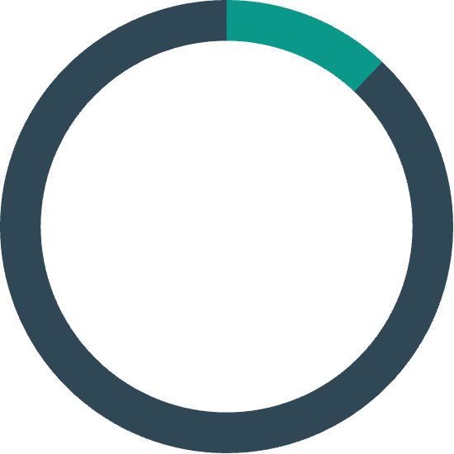
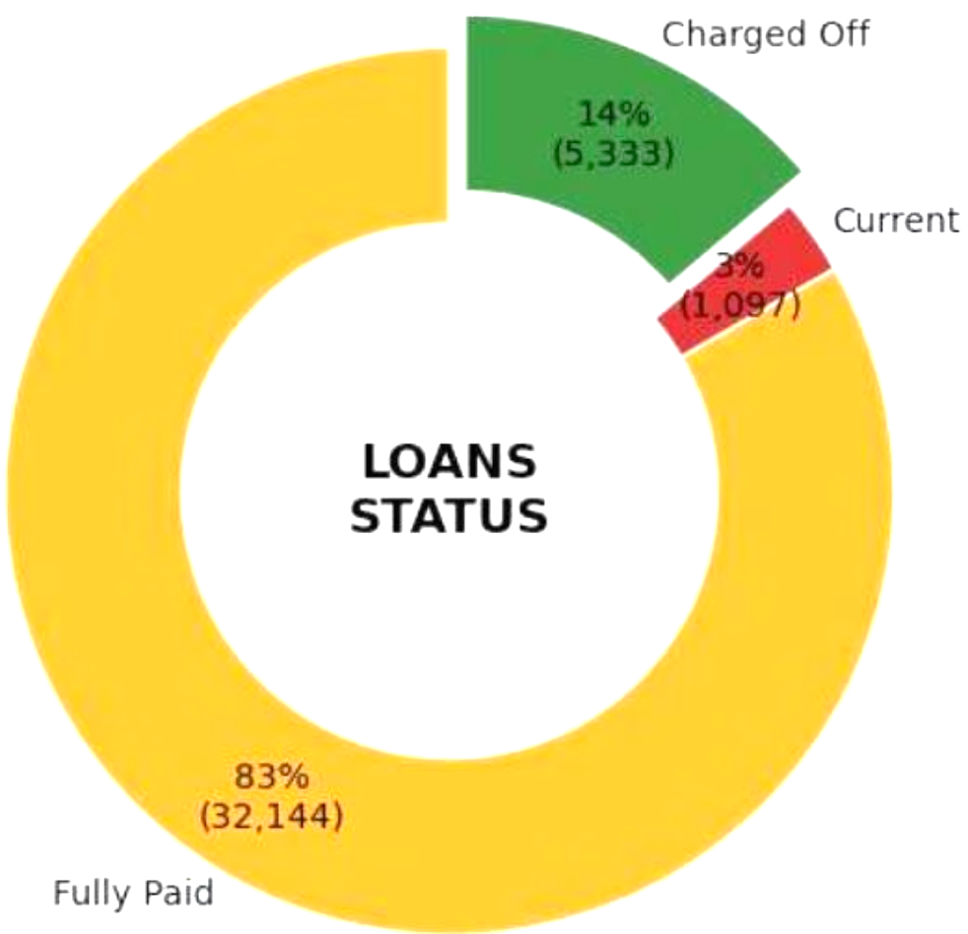
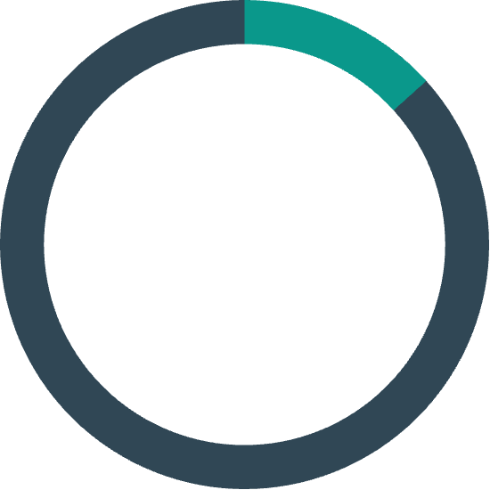
Loan Performance Metrics
12.05%
Average Interest Rate
13.33%
Loan Status Overview
Average DTI Ratio
A significant majority of loans, 83%, have been fully paid, indicating a strong repayment success rate.
These key financial indicators provide insight into the overall risk and profitability of the loan portfolio. The average interest rate reflects the cost of borrowing, while the Debt-to-Income (DTI) ratio indicates borrowers' capacity to repay.
The charged off rate stands at 14%, representing loans that are unlikely to be recovered.
Only 3% of loans are currently active or in progress, suggesting a mature portfolio with most loans either resolved or defaulted.

Slide 5
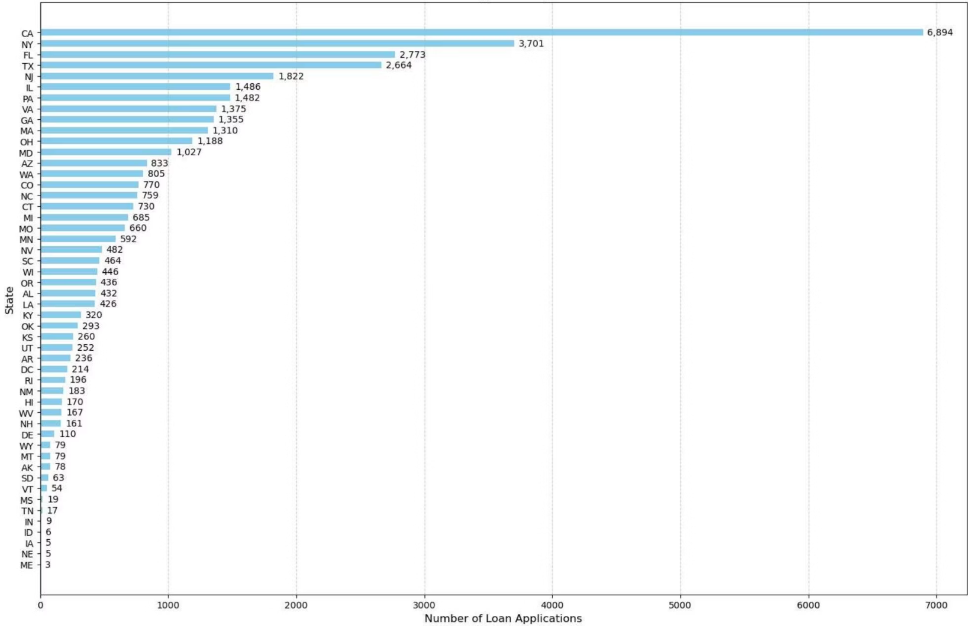
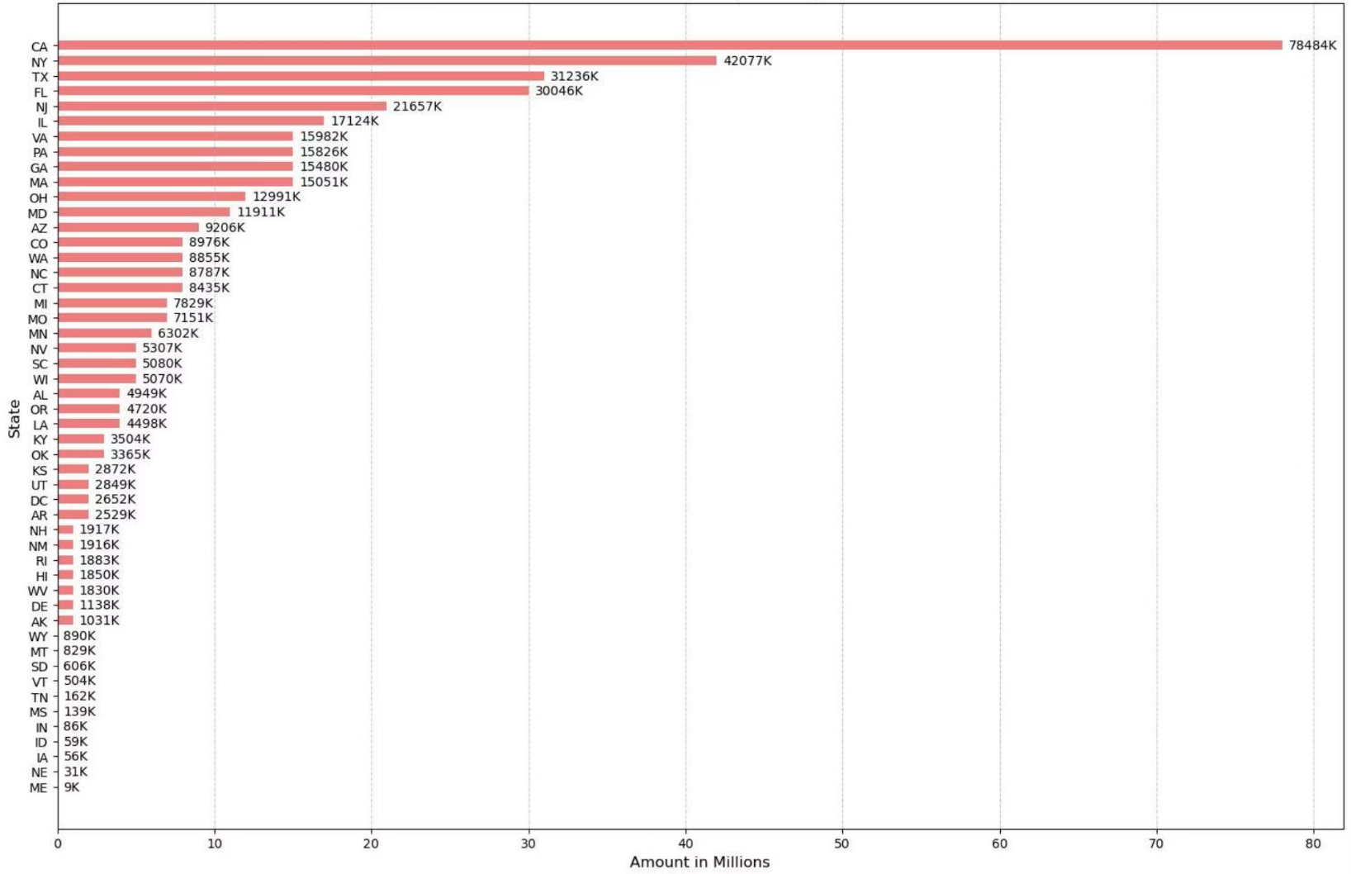
Regional Loan Distribution
Total Loan Applications per State
Total Fund Allocations per State
California leads in loan applications, followed by New York and Florida, indicating high demand in these populous states.
California also receives the largest share ($78484K)of funded amounts, consistent with its high application volume. This highlights key markets for loan distribution.

Slide 6
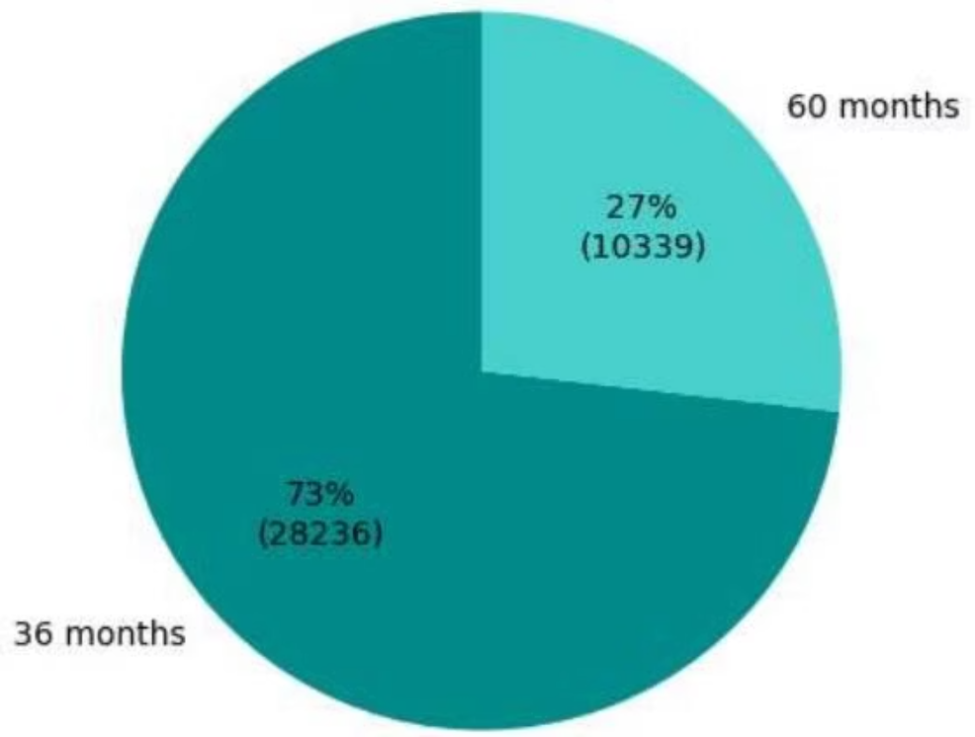
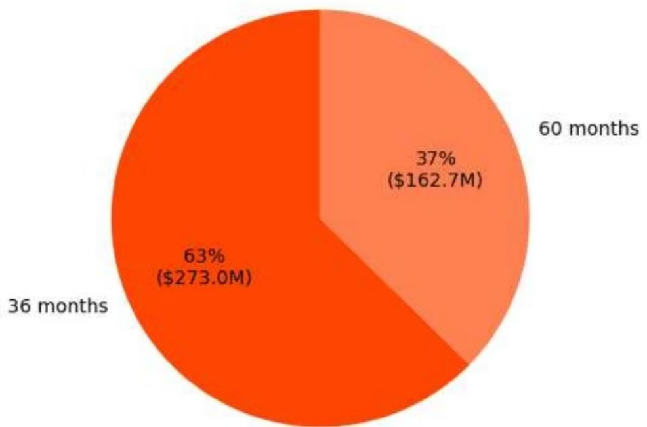
Loan Performance by Term
Applications by Tenure
Funded Amount by Tenure
The majority of loan applications are for 36-month terms, indicating a preference for shorter repayment periods.
The 36-month loans account for a larger portion of the total funded amount, indicating that shorter-term loans dominate the funding distribution.

Slide 7
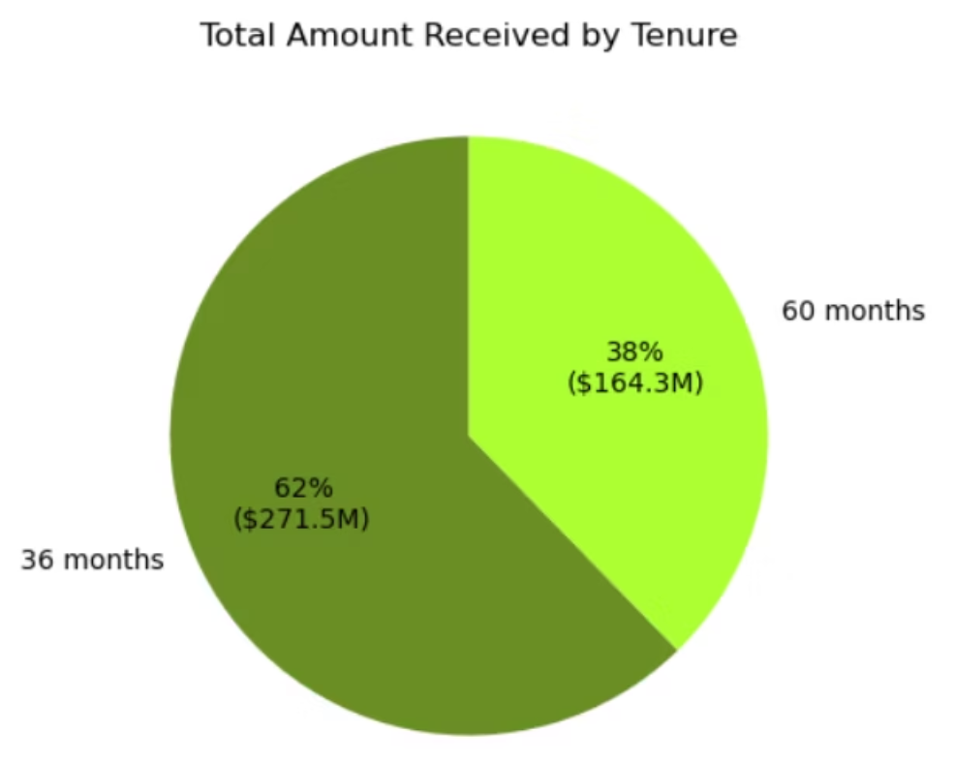
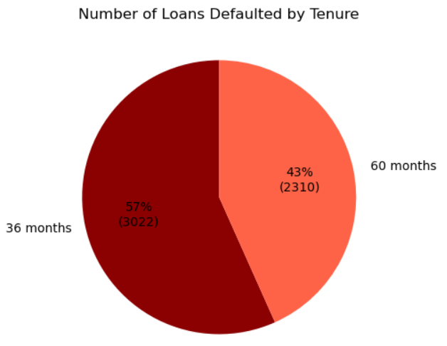
Loan Performance by Term
Total Amount Received by Tenure
Defaults by Tenure
The 60-month loan tenure accounts for 38% of the total amount received ($164.3M), while the 36-month loan tenure represent 62% ($271.5M).
Loans for 36 months have more defaults in absolute numbers, suggesting higher risk, while loans for 60 months represent a lower default rate.

Slide 8
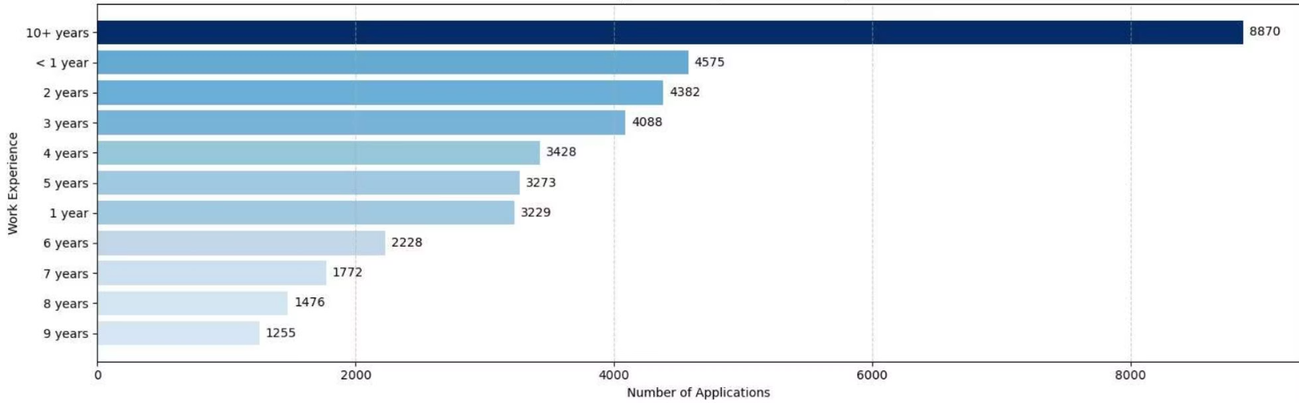
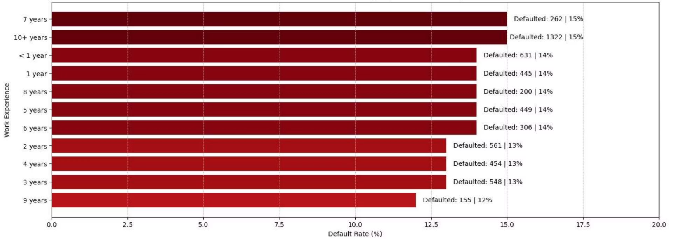
Impact of Work Experience on Loans
Loan Applications by Work Experience
Defaulted Volume & Rate by Work Experience
Clients with 10+ years & < 1 year of experience submit the most loan applications, followed by those with less than 1 year, indicating diverse borrower profiles.
Default rates vary across experience levels, with 7 years and 10+ years showing slightly higher percentages.
This suggests that experience alone doesn't guarantee lower risk.

Slide 9
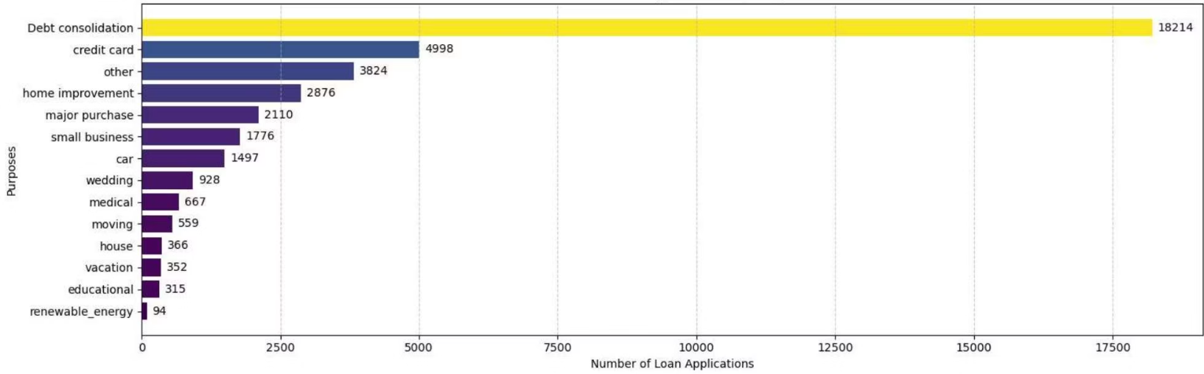
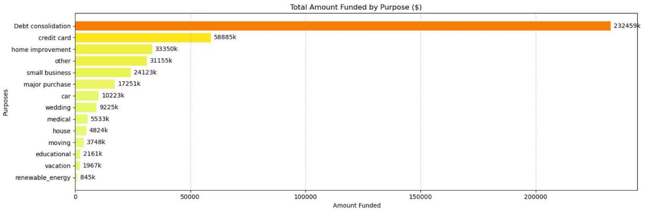
Loan Purpose Analysis
Applications by Purpose :
Funded Amount by Purpose :
Debt consolidation is the primary reason for loan applications, followed by credit card and other personal expenses. This highlights key areas of financial need among borrowers.
Debt consolidation also accounts for the largest portion of funded amounts, reinforcing its significance in the loan portfolio.

Slide 10
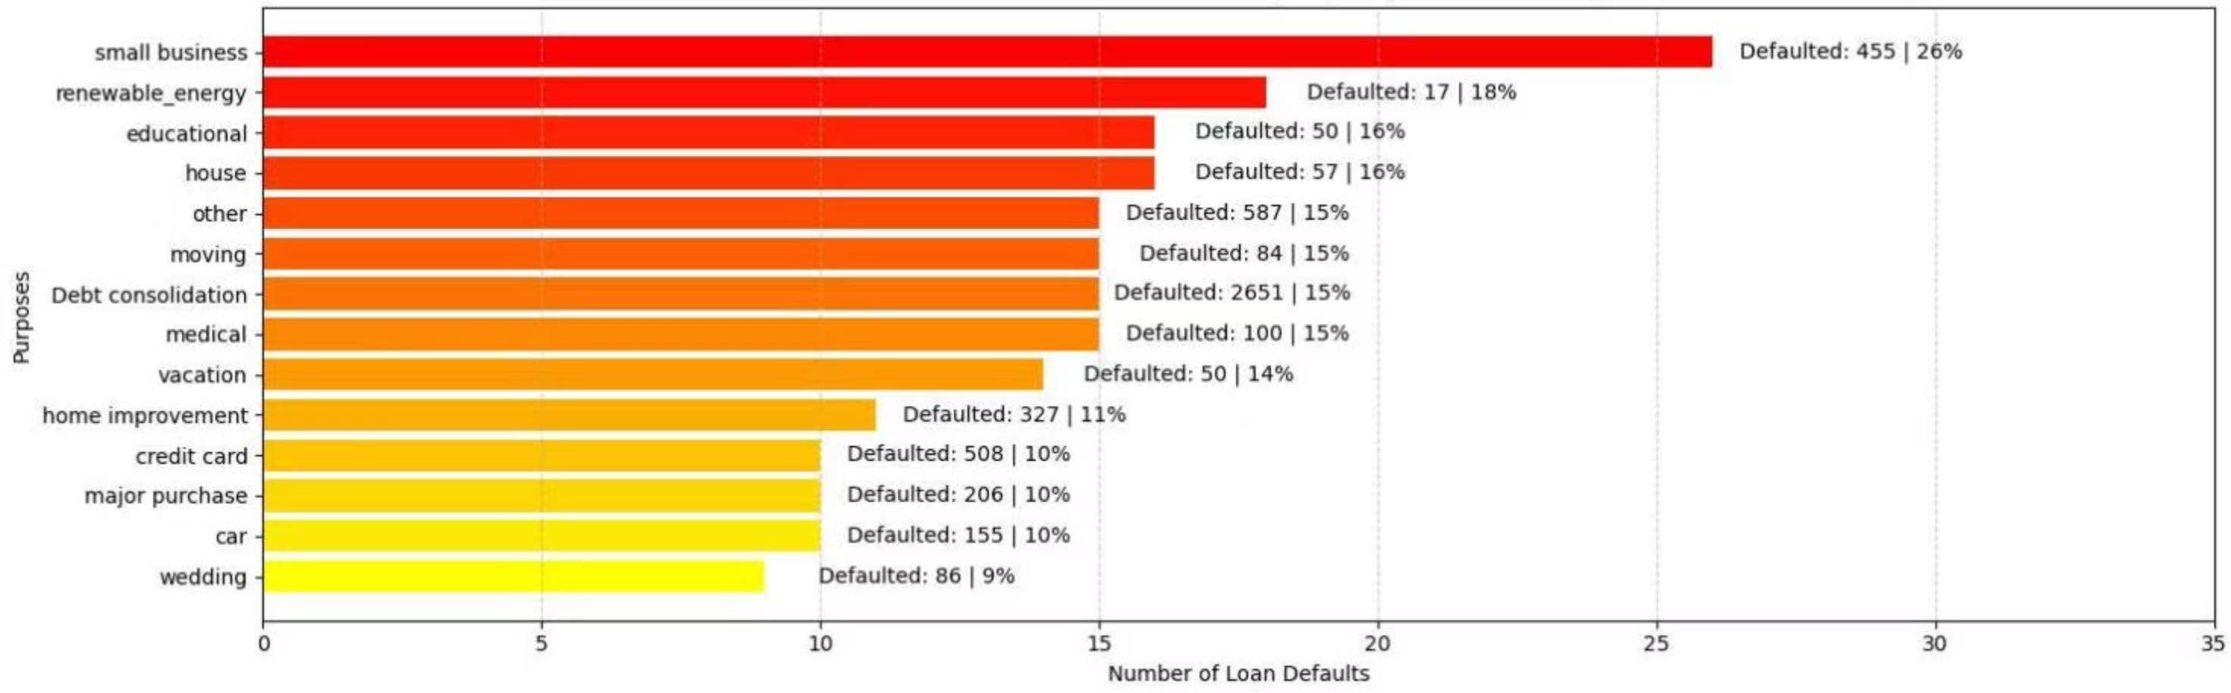
Default Rates by Loan Purpose & Home Ownership
Defaults by Purpose
Small business loans show the highest default rate, followed by renewable energy and educational loans, indicating a higher risk associated with this loan purpose. Understanding these patterns is crucial for risk management.

Slide 11
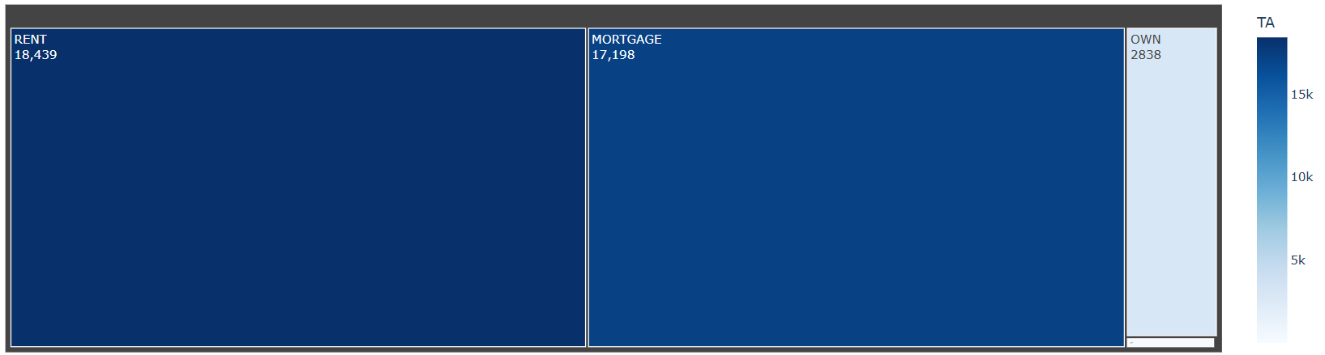
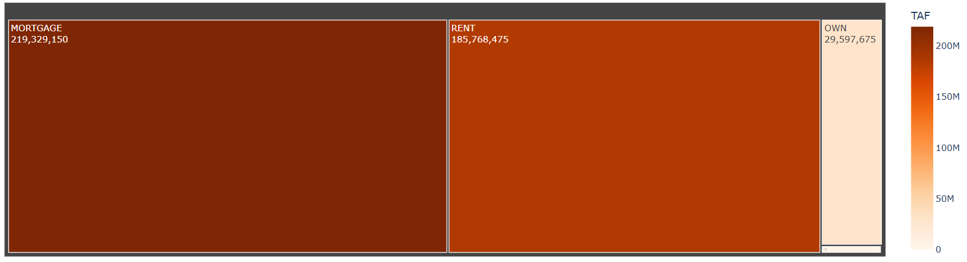
Home Ownership Analysis
Loan Applications by Home Ownership
Borrowers with a Rent or Mortgage account for the largest share of loan applications, reflecting typical housing situations.
Funded Amounts by Home Ownership
The distribution of funded amounts opposes application trends, with Mortgage holders has been funded higher amounts than the Renters

Slide 12
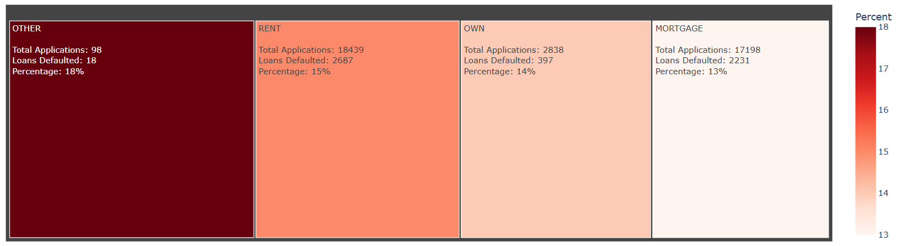
Home Ownership Analysis
Default Rates by Home Ownership
Borrowers with 'OTHER' home ownership status have the highest default rates, followed by 'RENT' and 'OWN’.
While Mortgage holders show the lowest default rate, suggesting greater financial stability.

Slide 13
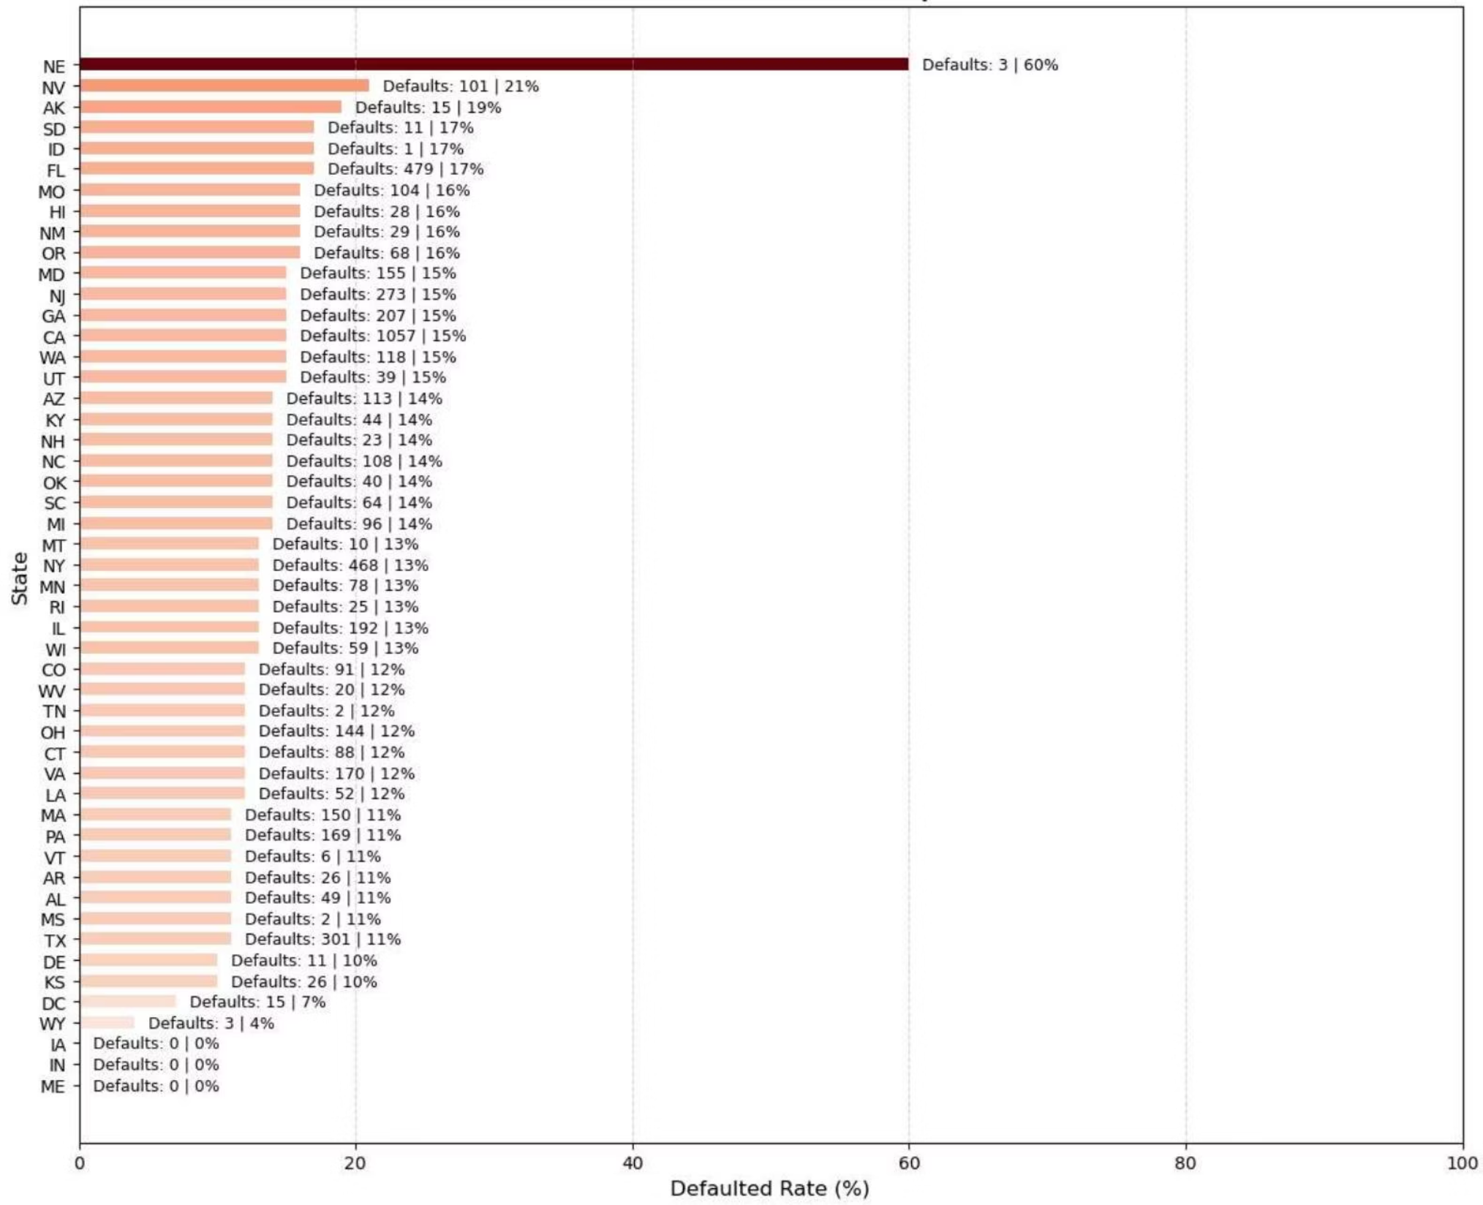
State-wise Defaulted Loans
Volume & Rate of Defaulted Loans per State
Nebraska (NE) exhibits the highest default rate at 60%, despite a low volume of defaults. Nevada (NV) and Alaska (AK) also show high default percentages. This regional analysis helps identify high-risk areas for lending.
Highest Default Rate
Nebraska (NE): 60%
Lowest Default Rate
Iowa (IA), Indiana (IN), Maine (ME): 0%

Slide 14
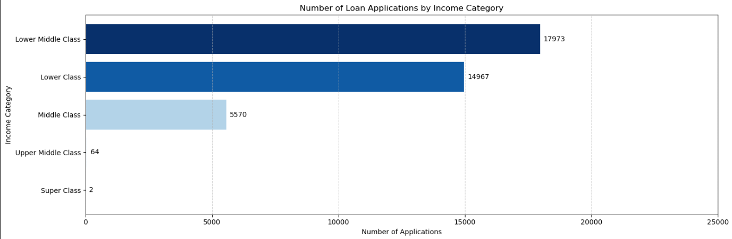
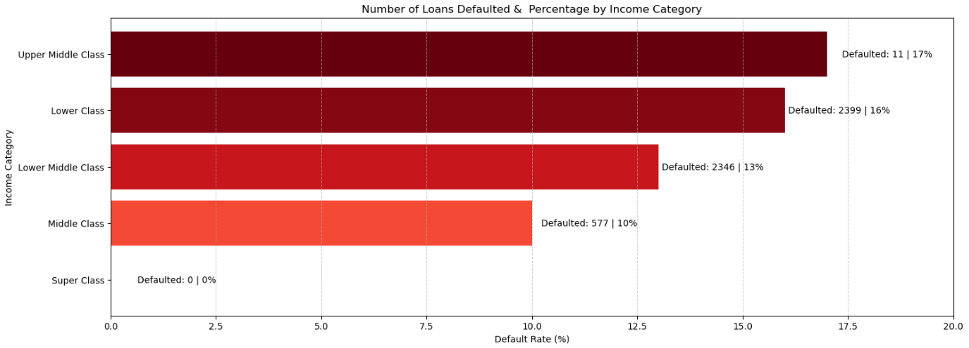
Impact of People’s Income on Loans
Loan Applications by Income Category :
Defaulted Volume & Rate by Income Category :
The Lower Middle Class (17,973) and Lower Class (14,967) contribute the highest applications
These segments are highly credit-dependent and represent the core customer base.
The Upper Middle Class has the highest default rate (17%) despite low application numbers.
A balanced credit strategy focusing on controlled expansion in the Lower Middle Class segment can maximise profitability while minimising NPAs.

Slide 15
Thank You!

